Slide 1

Presented By
Name | Student Code
Kashif Iqbal | BWU/BTD/24/068
Soumen Jana | BWU/BTD/24/073
Soumen Das | BWU/BTD/24/074
Sudipta De | BWU/BTD/24/079
Subir Ghosh Gope | BWU/BTD/24/123
Secure & Reliable: Data Transfer for Online Banking
Course: Computer Networks
Course Code: BTD50112
Department: Computer Science & Engineering – Cyber Security & Data Science
University: Brainware University

Slide 2
Roadmap
1
Introduction
9
OSPF Verification & End-Device Configuration
2
Problem Statement & Project Goal
10
Simulation Testing & Results
3
How Reliable Transfer Works
11
Numerical Problem: CRC Calculation
4
Proposed Cisco Packet Tracer Network
12
Receiver CRC Check & Error Demonstration
5
IP Addressing Plan
13
Reliability & Security Integration
6
Router & WAN Configuration
14
Conclusion & Future Scope
7
OSPF Routing Configuration
15
References
8
CLI Commands for OSPF Simulation

Slide 3
Why Reliable Data Matters in Online Banking
A network communication system that transmits sensitive banking data accurately, securely, and without loss or corruption.
Online banking carries critical information: account details, transaction amounts, and authentication data.
Error detection, acknowledgements, retransmission, and reliable transfer protocols ensure the receiver gets correct data.
Result: data integrity, transaction reliability, and secure communication.

Slide 4
The Challenge & Our Goal: A Reliable Multi-Site Banking Network
Problem Statement
Project Goal
Sensitive information moves between the Head Office, banking servers, and branch offices.
The network needs reliable communication, proper separation, dynamic routing, and secure transfer.
The original single-area OSPF design is divided into multiple areas to represent a larger, organized network.
Design and simulate a reliable multi-site banking network in Cisco Packet Tracer.
Area 0 for the Head Office, Area 10 for Banking Site A, Area 20 for Banking Site B.
VLANs logically separate the banking networks, and WAN links connect the sites.
Demonstrates CRC for error detection, TCP for reliable delivery, and TLS for secure communication.

Slide 5
Five Technologies, One Reliable Network
1
2
3
4
5
CRC
TCP
OSPF
VLANs
TLS
Detects transmission errors
Provides reliable data delivery
Dynamically finds routes between banking areas
Separate network traffic logically
Protects sensitive banking data through secure communication
Together, they improve reliability, organization, and security.

Slide 6
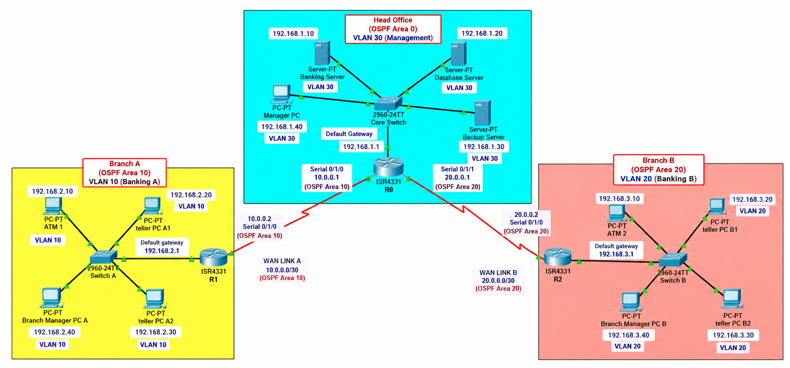
Network Blueprint: Three Sites, Three OSPF Areas
The Head Office connects to Branch A and Branch B through WAN links, with OSPF areas and VLANs organizing each banking site.

Slide 7
Addressing Blueprint: Networks, Areas & VLANs
Network | Address | OSPF Area | Purpose
Head Office | 192.168.1.0/24 | Area 0 | Management
Banking Site A | 192.168.2.0/24 | Area 10 | Banking Server A
Banking Site B | 192.168.3.0/24 | Area 20 | Banking Server B
R0–R1 WAN | 10.0.0.0/30 | Area 10 | WAN Link A
R0–R2 WAN | 20.0.0.0/30 | Area 20 | WAN Link B
VLAN 10 → Banking Site A
VLAN 20 → Banking Site B
VLAN 30 → Head Office Management

Slide 8
Router Roles & WAN Links: R0, R1 and R2
R0: Head Office Router / ABR
R1: Branch A Router
R2: Branch B Router
LAN: G0/0/0 → 192.168.1.1/24
WAN to R1: S0/1/0 → 10.0.0.1/30
WAN to R2: S0/1/1 → 20.0.0.1/30
OSPF Role: Area Border Router (ABR)
OSPF Areas: Area 0, Area 10 and Area 20
DCE: S0/1/0 → Clock rate 2000000
LAN: G0/0/0 → 192.168.2.1/24
WAN to R0: S0/1/0 → 10.0.0.2/30
OSPF Area: Area 10
VLAN: VLAN 10 (Banking A)
DCE: S0/1/0 → Clock rate 2000000 (only if this side is DCE)
LAN: G0/0/0 → 192.168.3.1/24
WAN to R0: S0/1/0 → 20.0.0.2/30
OSPF Area: Area 20
VLAN: VLAN 20 (Banking B)
DCE: S0/1/0 → Clock rate 2000000

Slide 9
Dynamic Routing: Multi-Area OSPF Configuration
R0: Head Office / ABR
R1: Branch A
R2: Branch B
router ospf 1
router-id 1.1.1.1
network 192.168.1.0 0.0.0.255 area 0
network 10.0.0.0 0.0.0.3 area 10
network 20.0.0.0 0.0.0.3 area 20
router ospf 1
router-id 2.2.2.2
network 192.168.2.0 0.0.0.255 area 10
network 10.0.0.0 0.0.0.3 area 10
router ospf 1
router-id 3.3.3.3
network 192.168.3.0 0.0.0.255 area 20
network 20.0.0.0 0.0.0.3 area 20
R0 connects all three OSPF areas and acts as the Area Border Router (ABR).
R1 operates completely within OSPF Area 10.
R2 operates completely within OSPF Area 20.

Slide 10
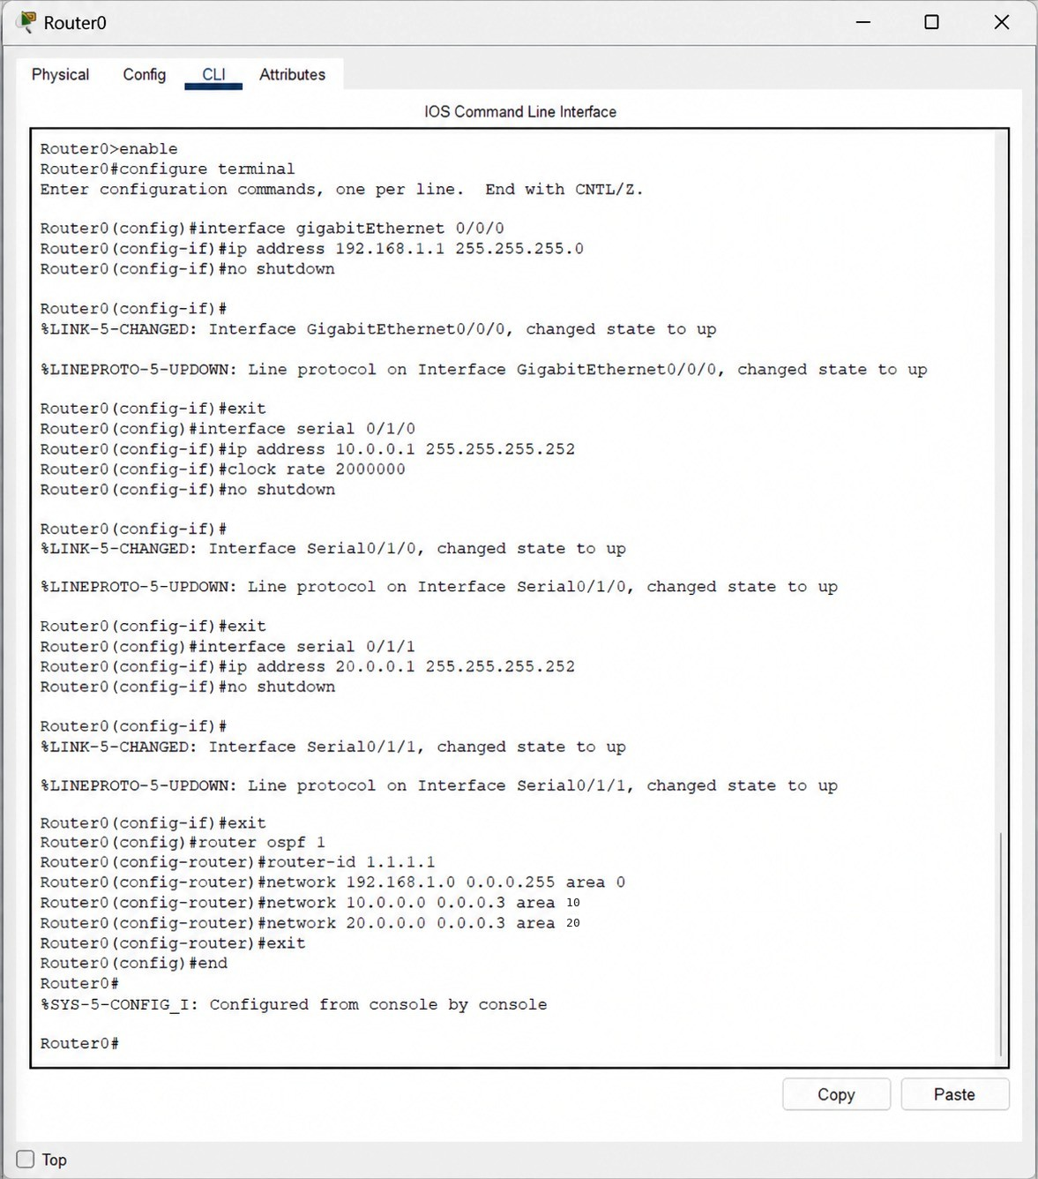
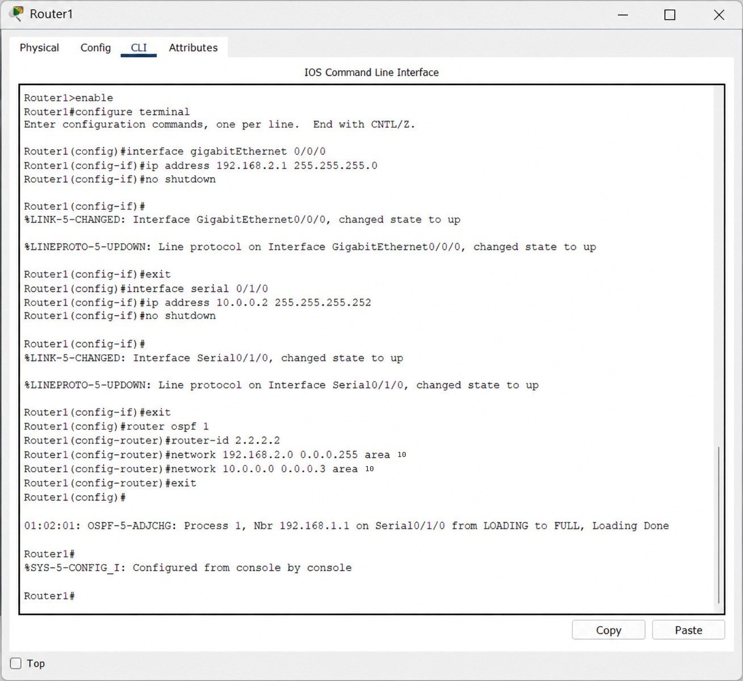
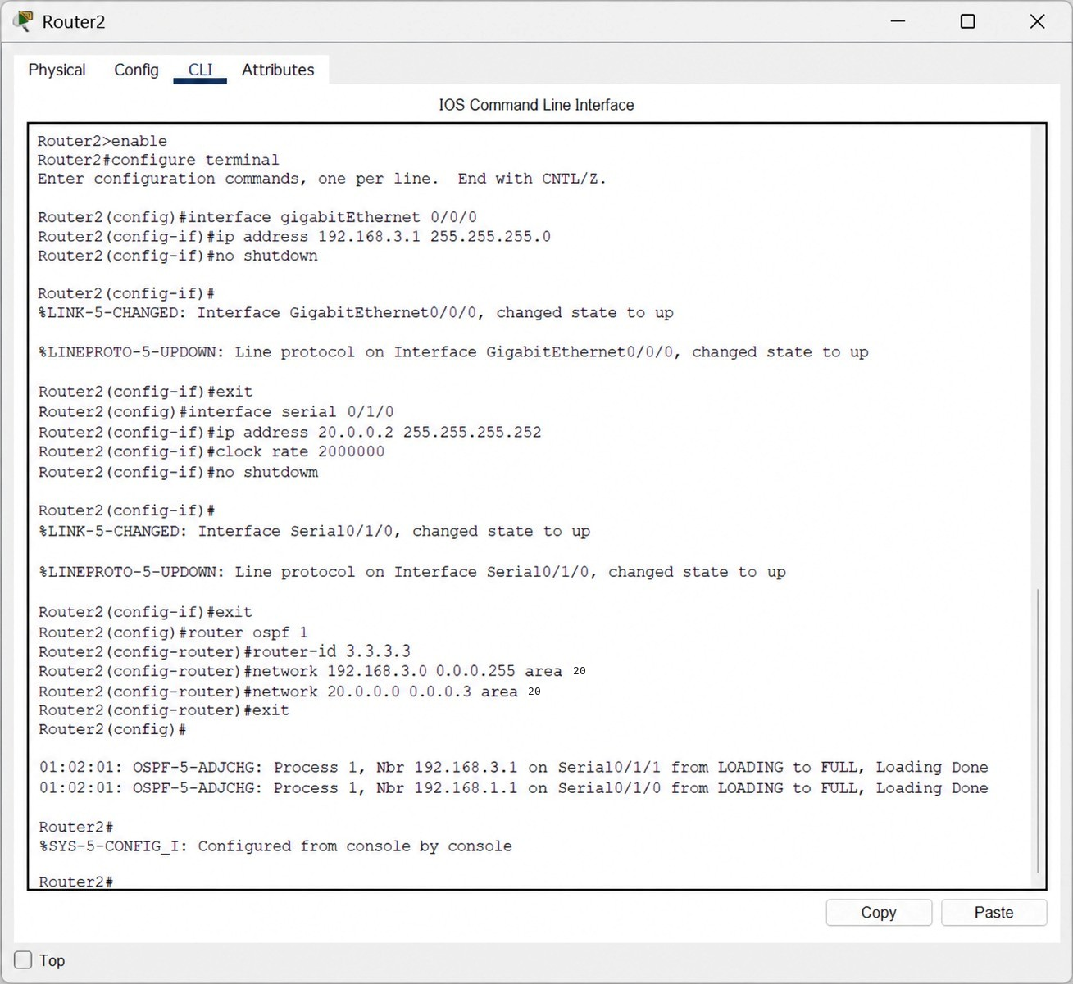
Live Configuration: OSPF CLI Commands in Packet Tracer
Router0: Head Office / ABR
Router1: Branch A
Router2: Branch B

Slide 11
Proof It Works: OSPF Verification & End-Device Setup
OSPF Verification
Command | What It Gives
show ip ospf | Displays the OSPF process details, including router ID, area assignments, router type such as ABR, timers, and overall routing process status.
show ip ospf neighbor | Lists all adjacent OSPF routers, showing their router IDs, neighbor states such as FULL, priority, dead timers, and connecting interfaces.
show ip ospf interface brief | Summarizes every OSPF-enabled interface with its process ID, area, IP address, link cost, current state, and neighbor count.
show ip route | Shows the routing table, including connected, local, and OSPF-learned routes marked with the letter O, along with next-hop addresses.
End-Device Configuration
Device | IP Address | Default Gateway | VLAN
Manager PC | 192.168.1.40 | 192.168.1.1 | VLAN 30
Banking Server A | 192.168.2.10 | 192.168.2.1 | VLAN 10
Banking Server B | 192.168.3.10 | 192.168.3.1 | VLAN 20

Slide 12
Test Results: Every Link Reachable, Zero Loss
Test | Destination | Result | Meaning
R0 → R1 WAN | 10.0.0.2 | 5/5, 100% | WAN link reachable
R0 → R2 WAN | 20.0.0.2 | 5/5, 100% | WAN link reachable
HO Manager → Branch A Manager | 192.168.2.40 | 4/4, 0% loss | Remote LAN reachable
HO Manager → Branch B Manager | 192.168.3.40 | 4/4, 0% loss | Remote LAN reachable
Branch A Manager → Branch B Manager | 192.168.3.40 | 4/4, 0% loss | Inter-branch routing works
5
ping tests
0%
packet loss on LAN tests
3
sites connected

Slide 13
Solving CRC: Step-by-Step Calculation
Data
1101011011
Step | Bits Taken | Divisor Used | XOR Result | Remainder Carried
1 | 11010 | 10011 | 01001 | 1001
2 | 10011 | 10011 | 00000 | 0000
3 | 00001 | 00000 | 00001 | 0001
4 | 00010 | 00000 | 00010 | 0010
5 | 00101 | 00000 | 00101 | 0101
6 | 01011 | 00000 | 01011 | 1011
7 | 10110 | 10011 | 00101 | 0101
8 | 01010 | 00000 | 01010 | 1010
9 | 10100 | 10011 | 00111 | 0111
10 | 01110 | 00000 | 01110 | 1110
Generator
10011
Data + 4 zeros
11010110110000
Generator is 5 bits, so 4 zeros are appended.
CRC remainder: 1110
Codeword: 11010110111110

Slide 14
Receiver Check: Catching Errors with CRC
Case 1: No error
Case 2: Bit error
Received: 11010110111110
Remainder: 0000
Data accepted
Third bit flipped: 11110110111110
Remainder: 1110
Rejected, retransmission requested
Case | Received Codeword | Remainder | Outcome
No error | 11010110111110 | 0000 | Accepted
Bit error | 11110110111110 | 1110 | Rejected
Key point: a zero remainder means the data is intact; any non-zero remainder means corruption occurred. TCP then retransmits the data.

Slide 15
Better Together: Reliability & Security Integration
CRC
Detects errors in transmitted data.
→ Error Detection
TCP
Provides reliable and ordered delivery of data.
→ Reliable Delivery
OSPF
Dynamic routing between Area 0, Area 10, and Area 20.
→ Dynamic Routing
VLAN
Logically separates banking and management traffic.
→ Network Segmentation
TLS
Protects sensitive information through encrypted communication.
→ Secure Communication
Combined outcome: accurate data, dependable delivery, efficient routing, organized traffic, and protected transactions across the Head Office and both branches.

Slide 16
Conclusion & Future Scope
Conclusion
Future Scope
Demonstrates a reliable and secure online banking network using Cisco Packet Tracer.
The Head Office and two branches are connected using multi-area OSPF, VLANs, and point-to-point WAN links.
CRC provides error detection, TCP ensures reliable delivery, and TLS provides secure communication.
1
Add more branches with additional OSPF areas.
2
Add redundancy with backup routers and links.
3
Add firewall and ACL configurations for sensitive resources.
4
Implement DHCP for automatic IP assignment.
5
Use network monitoring tools to detect failures and performance issues.
6
Expand VLANs for Accounts, IT, and Administration.
7
Add VPN and advanced authentication for remote banking communication.

Slide 17
References & Resources
[1]
J. F. Kurose and K. W. Ross, Computer Networking: A Top-Down Approach, 8th ed. Pearson, 2021.
[2]
A. S. Tanenbaum and D. Wetherall, Computer Networks, 6th ed. Pearson, 2021.
[3]
W. Stallings, Data and Computer Communications, 10th ed. Pearson, 2013.
[4]
W. Eddy, Ed., “Transmission Control Protocol (TCP),” RFC 9293, IETF, 2022.
[5]
E. Rescorla, “The Transport Layer Security (TLS) Protocol Version 1.3,” RFC 8446, IETF, 2018.
[6]
Cisco Systems, Inc., “OSPF Configuration Guide,” Cisco IOS Documentation.
[7]
Cisco Networking Academy, Cisco Packet Tracer, Cisco Systems.

